Slide 1
NoteSharing Application
Ali Kalpazan 170201006
Onur Tokdemir 190201001
Ozan Türkekul 200201042

Slide 2
Problem
The goal of this app is to help students share their notes and documents and deploy an effective solution. They will also be able to take/upload photo. Ex. e taking pictures of white boards with their Android devices. Additionally, they can send message to message board to request notes from other users.

Slide 3
Solution Approach
This project allows students to share their files easily. They can upload their files to the server and all users of the app can download them from there. The files are categorized according to the lessons so that users can find the notes easier.
The users can also use the app’s message board for communication.
The users also can take photo and directly upload it to server using the app.

Slide 4
Software Development Process
Applied Unified Process that is a popular iterative and incremental software development process framework.
The Unified Process is not simply a process, but rather an extensible framework which should be customized for specific organizations or projects.

Slide 5
Development Phases
Inception
Elaboration
Construction
Transition

Slide 6
Inception
We wrote vision document.
We defined the most risky requirements.
We prepared the system context diagram.
We wrote the glossary.
We prepared an iteration plan.

Slide 7
Elaboration
We defined all the requirements.
We completed the project design.
We draw system sequence diagrams.
We draw use case diagrams for the most important use cases.
We prepared a test plan.

Slide 8
Construction
We completed the most part of the coding.
We developed a working version of the program.
We prepared a diagram for the architecrutal design.
We deployed the java server code to amazon ec2.

Slide 9
Transition
We fixed the bugs.
We made the final adjustments.
We prepared the final version of the software.

Slide 10
Environment
Android Genymotion VirtualDevice Version: Lolipop 5.0 Android Nexus 5
Eclipse Luna (Java Servlet Side)
Android Studio (Android Side)
Junit 4
Windows Development PC
Amazon Linux running Tomcat 8 Java 8
Amazon Relational Database Service

Slide 11
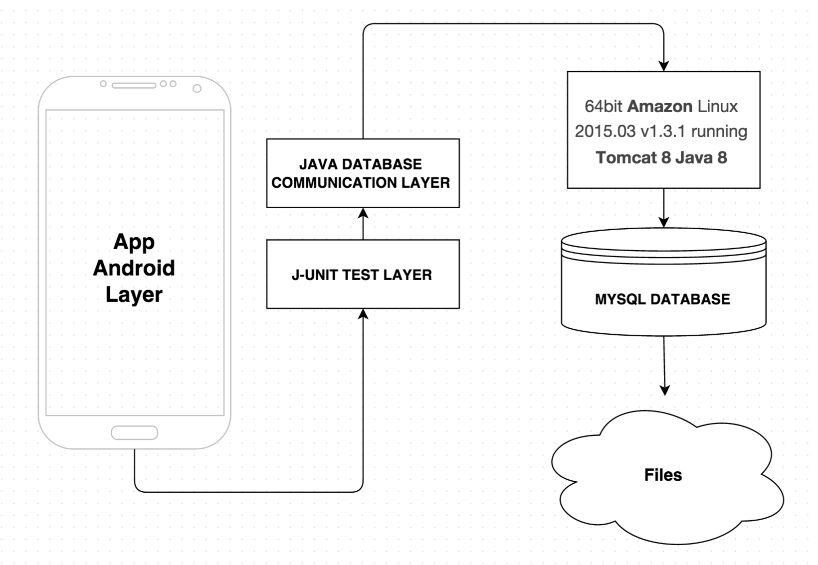
Architecture

Slide 12
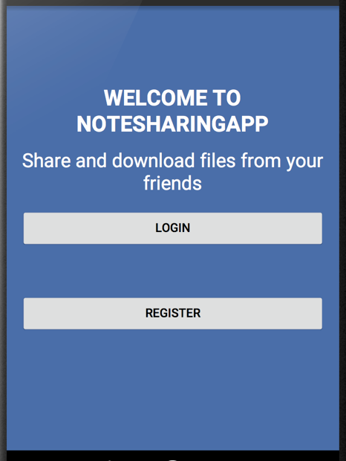
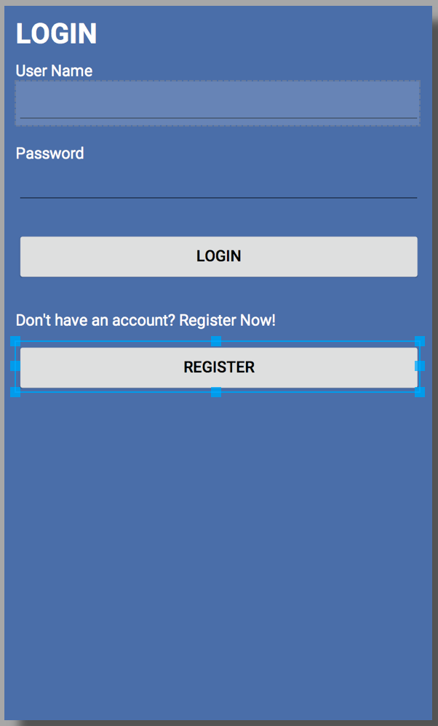
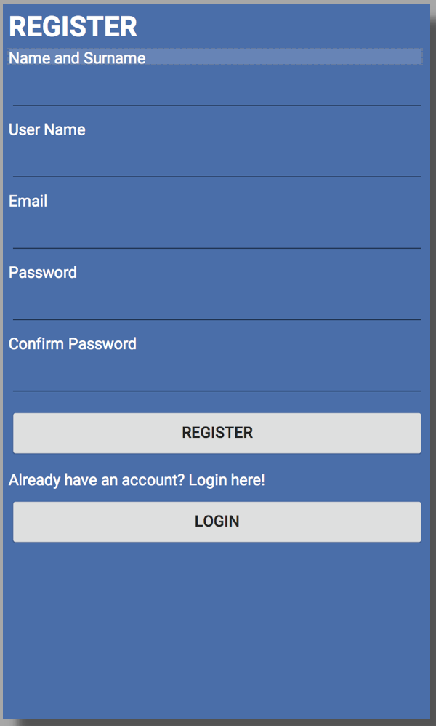
Interface

Slide 13
